Slide 1
NW London ICB Diabetes Programme
Update to Primary Care
11th October 2023

Slide 2
Contents This diabetes update for primary care includes:
Information on the new NDPP provider Thrive Tribe
Thrive Tribe will start to accept referrals from 1st December. (appendix 1)
Information sessions are being run in November. An option of 6 sessions are available. Book now.
Coming soon: Early Onset Type 2 Diabetes (EOT2D)(T2DAY) Service
NHS England has released funding to tackle Type 2 diabetes in the young (T2DAY). (appendix 2)
NW London allocation for this 2-year initiative (23/24 and 24/25) is £475k annually (£52 per patient) and is open to all PCNs.
The extended face-2-face 30 minute reviews aim to improve care for 9,135 patients aged 18-39 living in NW London with Early Onset Type2 Diabetes (EOT2D).
Add to you calendar the next T2DAY webinar on Thursday 19th October 5pmby national lead Dr Shivani Misra if you missed the first session on 4th October.
Coming soon: Diabetes Level 2 Service: Diabetes MDTs (Multi-Disciplinary Teams) & Initiation and Optimization of Insulin or GLP-1 Therapy
Diabetes MDT: : Funding is also available to support primary care in organising and developing Diabetes MDT meetings at the PCN (Primary Care Network) or Integrated Neighbourhood Team (INT) level. These meetings will involve collaborative efforts between PCNs/INTs and specialists from acute, community, mental health, and voluntary sector organisations. Practices will be compensated at a rate of £23.14 per patient for every patient discussed during MDT meetings. The primary objective is to enhance the quality of care, improve patient outcomes, reduce morbidity and mortality, and provide a seamless experience across all diabetes services in North West London.
Initiation and Optimisation of Insulin or GLP-1 Therapy: The goal of this initiative is to assist patients in achieving their glycaemic targets and reducing complication rates. Practices will receive £241.04 per patient for insulin initiation and £66.16 per patient for insulin optimisation
Scope of roll out is being agreed at borough level. (appendix 3)
REWIND Monitoring
Although the REWIND programme is no longer accepting new patients, patients who have started REWIND will need to have their medication, HbA1c, BMI, BP and cholesterol reviewed at 3, 6 and 12 months. (appendix 4)
REWIND Enhanced Service payments for monitoring will be made up until July 2024.
Code your patients who have completed digital structured education + those patient who have created a KDS account
Practices will be paid £1 for every KDS account created amongst their practice population from 1st July 2023. (appendix 5)
You will have received this data to your nominated email last month.

Slide 3
Appendix 1: New NDPP Provider – Thrive Tribe

Slide 4
New Provider for NDPP Framework 3 contract
Following a national tendering process led by NHS England for the NHS Diabetes Prevention Programme(NDPP) Framework 3 and approval from the NHS Commercial Executive Group, Thrive Tribe have been successful in securing the NDPP Framework 3 contract for North West London ICS replacing Xyla.
Thrive Tribe’s digital partner will be Second Nature.
New Framework start date 1st December 2023.

Slide 5
Thrive Tribe: NHS Diabetes Prevention Programme Webinars - GPs / Health Care Professionals this one’s for you!
Thrive Tribe are running webinars to explain how this change will affect you and how preventing type 2 diabetes is in everyone’s best interest
Learn how to gain back time, earn £11.50 per patient starting the NDPP programme and improve the long-term health of your patients in one 45-minute webinar!
Sign up to one of the following sessions:
Thursday 2nd November, 12:30 – 1:15pm
Wednesday 8th November, 12:30 – 1:15pm
Thursday 9th November, 1-1:45pm
Thursday 16th November, 12:30-1:15pm
Wednesday 22nd November, 12-12:45pm
Thursday 23rd November, 12:30-1:15pm
You’ll learn:
Who …is responsible? Thrive Tribe can support patients to prevent type 2 diabetes through their nine month Healthier You NHS DPP programme. Learn who they are and what the programme offers.
Why …should you care? We know that making a Healthier You NHS DPP referral is another item on a very long to-do list. Dr Richard Pile will explain just why making a referral will benefit you, the practice and the patient.
How …do you make a referral? All your questions will be answered.
Sign up to the webinar

Slide 6
Appendix 2: Early Onset Type 2 Diabetes (EOT2D) Service

Slide 7
Early Onset Type 2 Prevalence
Executive Summary
NW London Population with type 2 Diabetes aged 18 – 39 years
Dec 2022 | Mar 2023 | Forecasted including growth Mar 2025
8,235 | 8,609 | 9,135
There are increasing number of people with early onset Type 2 diabetes(EOT2D) sometimes referred to Type 2 Diabetes in the Young(T2DAY).
Its forecasted that the number of NW London patients will increase from 8,609 to 9,135 by March 2025(+526).
Disproportionately affects those from minority ethnicities (particularity Asian) and those living in the most socio- economically deprived areas.
Latest NDA analysis (unpublished) shows that most people aged 19 39 years with EOT2D are cared for exclusively in primary care.
There are approximately 20 people aged 18 – 39 years old per practice, on average. This works out at between 39 - 521 patients with EOT2D per NW London PCN.
Most women with Type 2 diabetes who become pregnant are not prepared for pregnancy, and where blood glucose is not less than 48mmol/mol they are at increased risk of adverse maternal and neonatal outcomes.
A targeted improvement approach will improve outcomes for people with diabetes and reduce health inequalities downstream activity and healthcare costs.

Slide 8
Early Onset Type 2 Diabetes Service Model
Person aged 18-39 with Type 2 Diabetes receives extra 30 min face-to-face review(s)
Executive Summary
For Delivery in the f-2-f 30 minute reviews:
Supportive Services for onward referral:
Psychological wellbeing services
Completion of any remaining care processes
Consideration of potential misclassification of diabetes type
Optimisation of glycaemia, cardiovascular risk and weight
Contraception and planning for possibility of pregnancy
Psychological wellbeing services
Social prescribing
Weight management services
Structured education
Peer support
Remission programme
Contraception services
Pre-conception clinics
Funding and commissioning:
Funding allocations for systems have been based on the number of people with EOT2D in each system (NDA quarterly data – 2022/23 Q3).
£52 per adult with EOT2D
Find draft service specification here: Diabetes Early Onset Type 2 Service Specification.docx

Slide 9
Training & Education – EOT2D/T2DAY The expectation is that one GP and one nurse from each PCN should attend a session as well as a clinical pharmacist where possible
About the Training | Speaker | Dates & Times | Links To Join / Calendar Invite
National funding has been allocated to all practices/Primary Care Networks (PCNs) in NW London for the implementation of the T2DAY: Type 2 Diabetes in the Young Program. This is a 2-year initiative, spanning from 2023/24 to 2024/25, with the goal of enhancing care for individuals with EOT2D. The training will encompass the five key components of the T2DAY intervention, emphasizing best practices in each area while focusing on addressing any grey areas that may require further discussion or input. This training represents a valuable opportunity to enhance the quality of care provided to individuals with Early Onset Type 2 Diabetes in NW London. We encourage all relevant personnel to participate and take advantage of this initiative. | Shivani Misra (MBBS, FRCP, PhD) Physician & scientist in diabetes and metabolic medicine National Lead for Early Onset T2Diabetes Programme https://pubmed.ncbi.nlm.nih.gov/35900910/ Consultant Physician in Diabetes and Metabolic Medicine at Imperial College Healthcare NHS Trust Welcome Trust Career Development Fellow Honorary Senior Clinical Lecturer in Diabetes and Endocrinology at Imperial College London | There are two identical training sessions available: Date: Wednesday 4th October 2023 Time: 12:00 PM – 1:00 PM Date: Thursday 19th October 2023 Time: 5:00 PM – 6:00 PM | Please See Microsoft link to join below, please note you only need to attend one session. Wednesday 4th October 2023 Click here to join the meeting Thursday 19th October 2023 Click here to join the meeting A Calendar invite for both dates will also be sent out; you only need to accept one date. Please contact us if you have any further questions, contact details below: Ealing Training Hub Contact : Iza Rana nhsnwl.education@nhs.net

Slide 10
Appendix 3: Diabetes Multidisciplinary Team (Level 2) Service - Diabetes MDTs (Multi-Disciplinary Teams) - Initiation and Optimization of Insulin or GLP-1 Therapy

Slide 11
Core principles
- Redesigning a fit for purpose pathway
Executive Summary
NWL Integrated Service Specification was finalised in 2020 – it was an ambitious document which was co-produced by a large number of stakeholders, including clinicians, commissioners, service leads and service users.
The document contains some core principles:
Outcomes focus
Reducing health inequalities
Person-centric
A requirement for multi-disciplinary approaches
The need to address wider health and wellbeing requirements

Slide 12
Tier 2 scoping
Executive Summary
The NWL Diabetes Transformation Programme team was asked at the beginning of June to update the tier 2 diabetes specification, focussed on injectable initiation and optimisation
The scope has now broadened to allow a wider remit which includes establishing Multi-Disciplinary Team meetings in each PCN:
A population health focus, allowing proactive, data-driven intervention - not just injectable initiation and optimisation.
Establishment of an MDT per PCN/INT in close collaboration with specialist diabetes teams consisting of members of primary care, community specialist providers, mental health and other professionals such as social prescribers. We want to work with the community provider collaborative and acute provider collaborative to ensure that these are well resourced
MDT case discussion including those identified by data for discussion
A more streamlined pathway to mental health support
A service that aims to address wider social concerns. Social and mental factors are frequent barriers to effective self-management and engagement in health interventions

Slide 13
MDT Level 2 Specification
Executive Summary
Establish an MDT per PCN consisting of a primary care team lead(s), diabetes specialist clinician, mental health practitioner, social prescriber / link worker and other MDT members as needed
Hold regular (frequency TBD) MDT sessions
Accept referrals for care optimisation from other practices within the PCN/Integrated Neighbourhood Team/Borough
Use data driven approaches to identify patients from within the PCN/INT in most need of additional clinical input. This will follow a prioritisation approach - this will require either
Use of WSIC RADAR to identify cohorts of patients for discussion (at least one member of the team will require access to data from all practices in the locality
Reports from SystmOne/EMIS reporting modules at PCN/INT level.
Initiate / optimise injectable therapies
Ideally the MDT would also link in other specialists e.g. CVD, CKD
PCNs may choose to just run with the MDT component this financial year while getting trained in injectable initiation

Slide 14
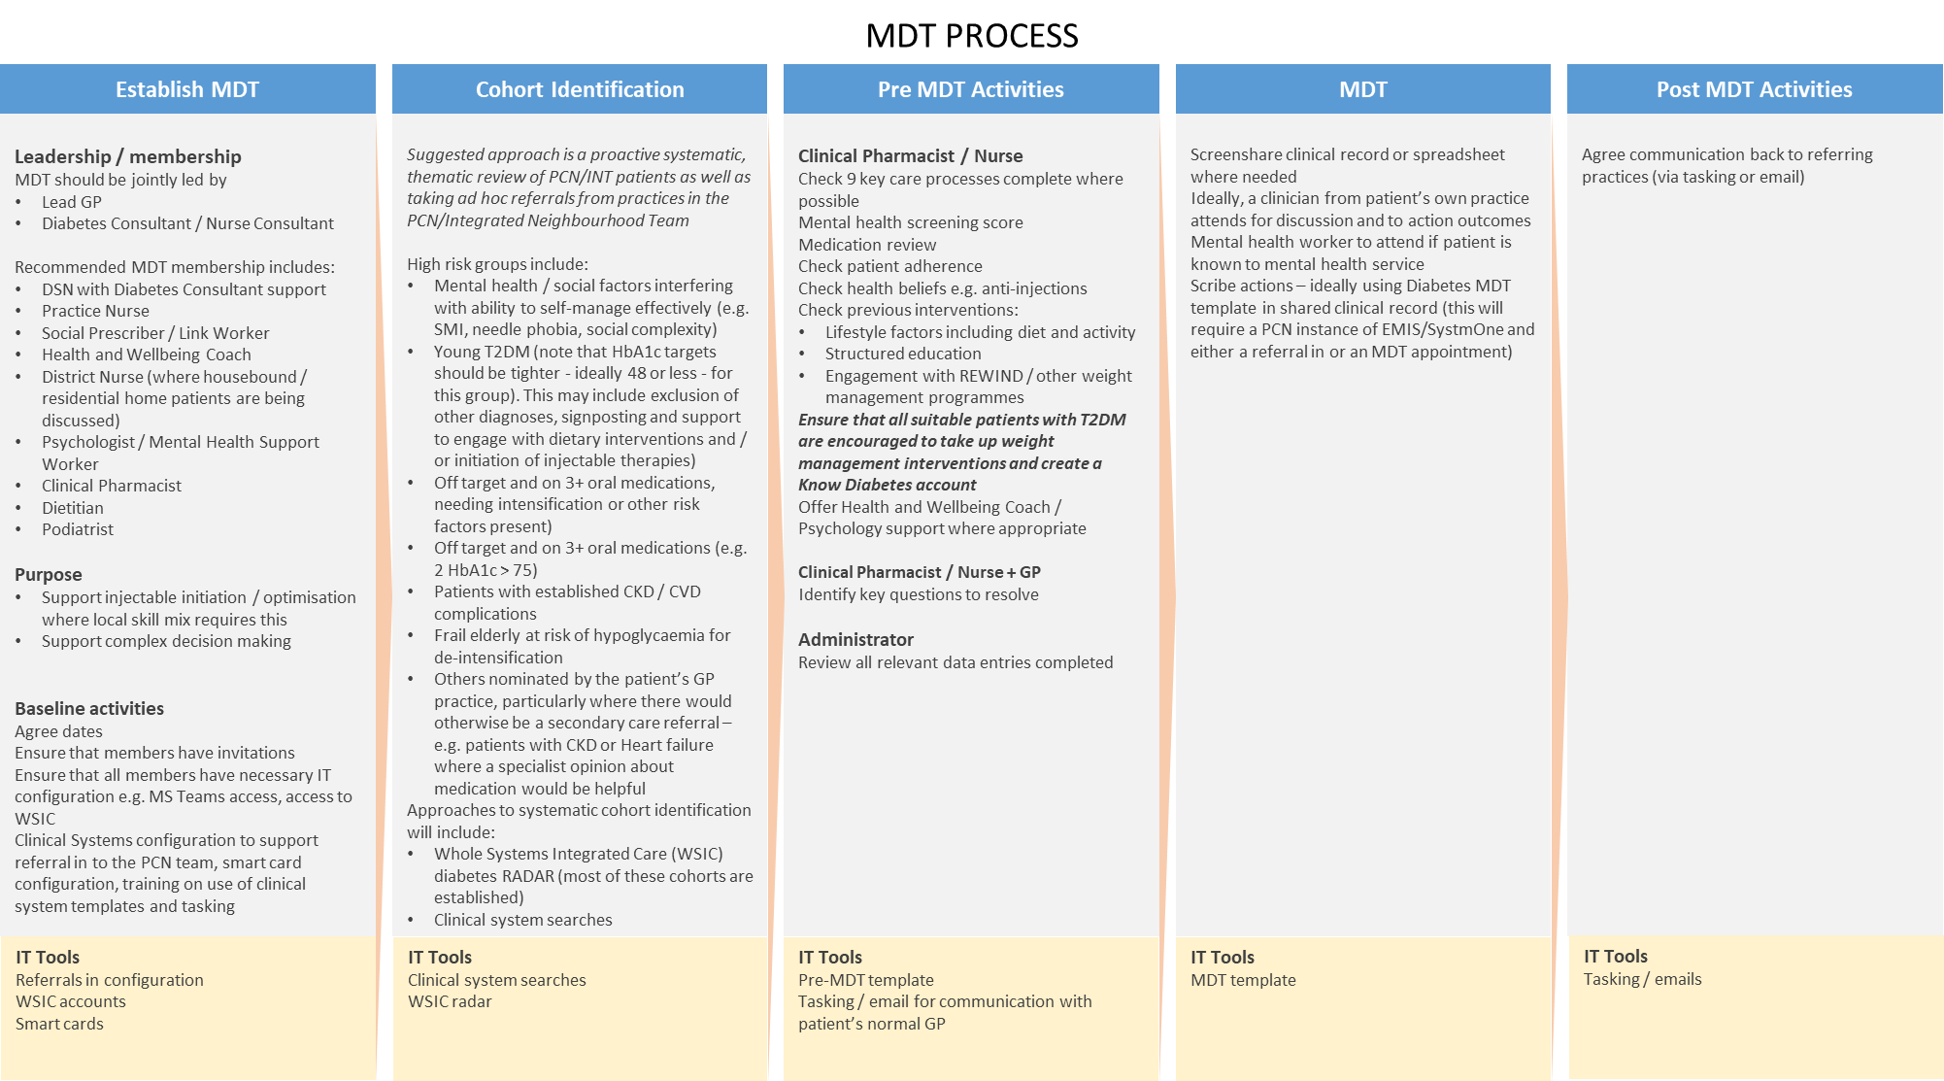

Slide 15
Example pathway for a patient with Early Onset Type 2 Diabetes
Illustrating that one patient may attract payments for more than one service.
Note that the EOT2D review is a separate but linked service specification.
All onwards referrals are examples only, but are illustrative of the kind of support which may be required.

Slide 16
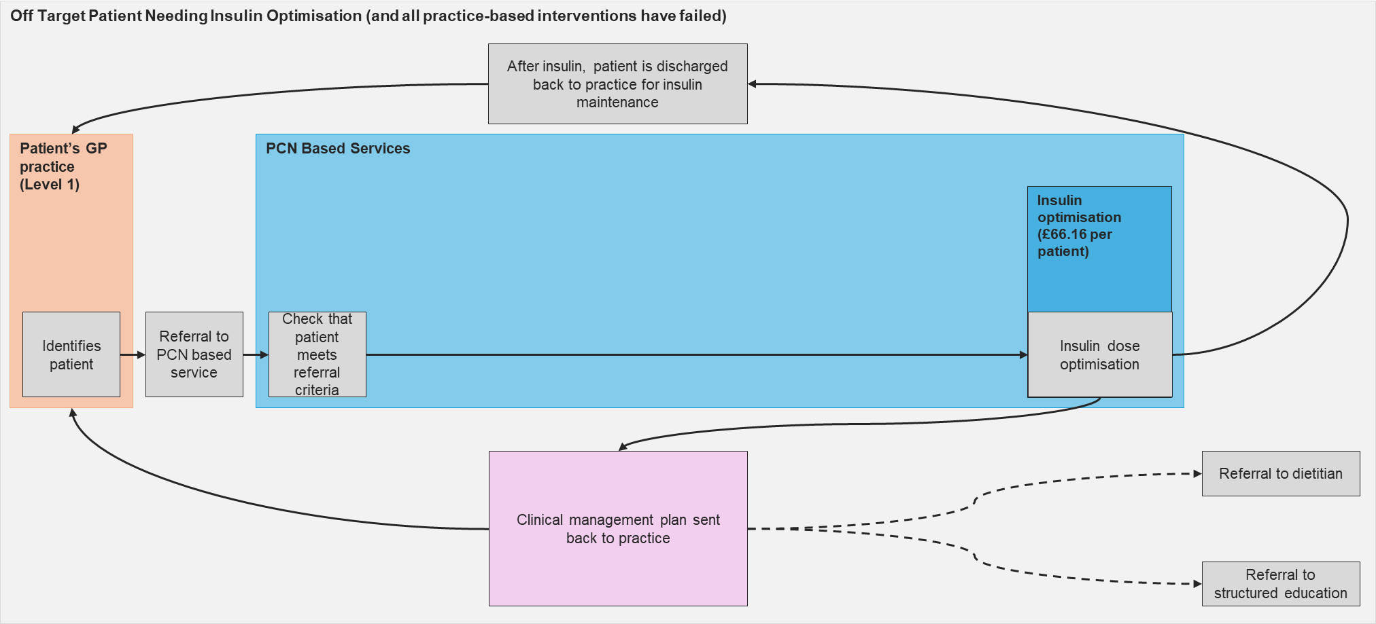
Example pathway for a patient referred by their GP practice requiring insulin optimisation but not MDT review
All onwards referrals are examples only, but are illustrative of the kind of support which may be required.

Slide 17
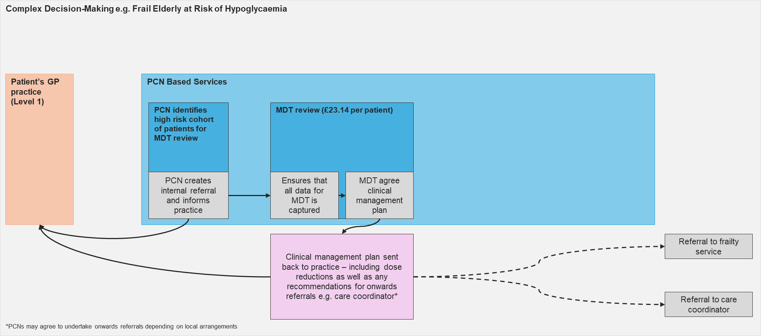
Example pathway for a patient identified through PCN-based clinical system or WSIC searches
In this case the MDT recommendation back to the patient’s practice is for de-intensification of diabetes medication and onwards referral to a frailty service and care coordinator.

Slide 18
Training & Education – PITstop Foundation (PrePITstop) Diabetes Course NWL Training Hub are funding THREE places per PCN from the ARRS roles of either Pharmacists, Paramedics or Physician Associates to complete the PITstop Foundation (PrePITstop) Diabetes Course
About the Training | Who is the Training for? | Registration Details
This 3-day multidisciplinary diabetes foundation course focuses on the core diabetes services and care provision for people with type 2 diabetes and prediabetes and emergency management for people with type 1 diabetes. It is aimed at healthcare professionals working in primary care who want to work as a team to improve diabetes services and patient outcomes using structured care pathways. What will be covered? Classification and accurate diagnosis Diabetes screening for at risk groups Day to day living choices Encouraging referrals to the Diabetes Prevention Programme and Structured Education The oral diabetes medication pathway and related subjects (DVLA, hypoglycaemia, monitoring, concordance, individual target setting) Managing illness The provision of essential diabetes care using structured care pathways Cardiovascular disease prevention, including blood pressure, lipid and kidney management Eye screening and diabetes eye complications Emotional and mental health The foot assessment, foot advice and appropriate referral Preconceptual counselling and family planning advice (self-directed learning) Case studies: putting it into practice Use of audit to improve outcomes | This training is for THREE places per PCN from the ARRS roles of either Pharmacists, Paramedics or Physician Associates working as part of a practice/PCN diabetes team. | Please email nomaan.omar@nhs.net with: the three clinicians names, NHS email addresses, role practice/employer; PCN NW London Training Hub will then send them instructions of how to register onto the course.

Slide 19
PITstop Advanced (Injectable Therapies) Diabetes Course NWL Training Hub are funding TWO clinicians per PCN (this can either be Nurses, GPs or Pharmacists) to complete the PITstop Advanced (Injectable Therapies) Diabetes Course
About the Training | Who is the Training for? | Registration Details
This practical 2.5-day advanced course gives multi-disciplinary, practice teams the resources to work towards an enhanced diabetes service provision for injectable initiation (type 2 diabetes only). What will be covered? Revision of diabetes oral medications GLP-1 Agonists, including initiation using a structured care pathway Insulin: building the profile Injection technique Device workshop Detective work at review appointments focusing on injectables Insulin safety (self-directed learning) When is insulin indicated? Working through the PITstop insulin pathway to assess for insulin, initiate an appropriate insulin regimen and support the patient for the first 6-months: a case study approach Changing insulin regimens Dietary considerations and insulin, including minimising weight gain Decisions about injectable therapies: a case study approach Embedding the learning and university accreditation | This training is for TWO clinicians (GP, Nurse Practitioner, Practice Nurse and Clinical Pharmacist) per PCN working as part of a practice/PCN diabetes team, that are already experienced in providing a diabetes service and have attended a foundation level diabetes course or can provide evidence of self-directed learning, focusing on the oral diabetes medication pathway. It is preferable that they have undertaken their Independent prescribing, but not essential. | Please email nomaan.omar@nhs.net with the two clinicians names, email addresses, roles; practice(s)/employer; PCN mentors name and role along with the evidence that they have completed the foundation level diabetes course or equivalent. NW London Training Hub will then send them instructions of how to register onto the course.

Slide 20
Appendix 4: REWIND Monitoring

Slide 21
REWIND Starters The tables below show the total starters achieved split by borough and pathway, totals and the last 3 months of starters.
Low Carb M1's | Total | May 23 | Jun 23 | Jul 23
Brent | 207 | 8 | 9 | 1
Central (Westminster) | 59 | 0 | 8 | 2
Ealing | 234 | 4 | 11 | 1
Hammersmith & Fulham | 114 | 2 | 4 | 0
Harrow | 190 | 8 | 13 | 3
Hillingdon | 242 | 12 | 8 | 2
Hounslow | 321 | 7 | 7 | 1
West London | 80 | 1 | 2 | 2
Total | 1,447 | 42 | 62 | 12
TDR M1's | Total | May 23 | Jun 23 | Jul 23
Brent | 204 | 8 | 7 | 6
Central (Westminster) | 52 | 2 | 1 | 1
Ealing | 112 | 4 | 3 | 1
Hammersmith & Fulham | 96 | 5 | 4 | 0
Harrow | 139 | 6 | 6 | 2
Hillingdon | 160 | 7 | 10 | 1
Hounslow | 208 | 5 | 3 | 1
West London | 62 | 4 | 4 | 2
Total | 1,033 | 39 | 37 | 13

Slide 22
REWIND monitoring Patients who have started REWIND need to be monitored. These patients will need to have their medication, HbA1c, BMI, BP and cholesterol reviewed at 3, 6 and 12 months.
Practices can check to see which patients are due for REWIND monitoring via either:
Data quality searches for REWIND on SystmOne and EMIS.
SystmOne: NW London ICB >> NWL Enhanced Services DQ 2023 24 >> 05 Diabetes REWIND
EMIS: NWL Enhanced Services 2023 24 >> 05 Diabetes REWIND >> Data Quality
WSIC dashboard (visual below). Email the WSIC Dashboards Team at nhsnwl.wsicsupport@nhs.net for access

Slide 23
Where to get dashboard data An MS teams area has been set up with information about the NW London Diabetes Enhanced Service.
The location of the latest dashboards can be found by using the following steps or by clicking this link: Diabetes Dashboards
Click the ‘Teams’ icon on the top left hand
Then find the team labelled ‘NHS North West London Diabetes Programme’ ( it should be green) and click the subheading ‘PC Diabetes Enhanced Service’. If you need to be granted access then request access or email nhsnwl.diabetes@nhs.net
Click the ‘Files’ button at the top
Open the folder entitled ‘Diabetes Dashboards’

Slide 24
Appendix 5: KDS Updates

Slide 25
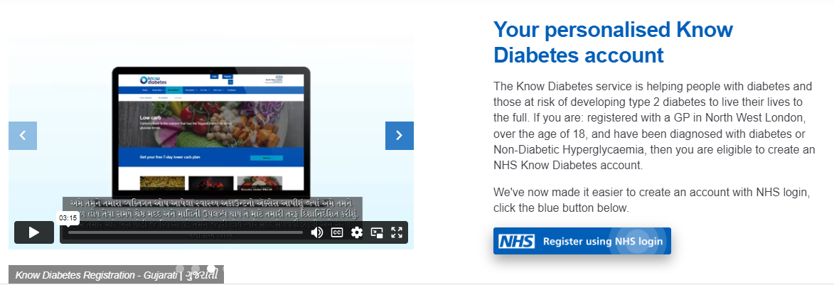
Know Diabetes Service NHS Login goes live
Please direct people to www.knowdiabetes.org.uk/register

Slide 26
Over 20,000 patients across NW London now have a NHS Know Diabetes Service account
Borough | KDS accounts
BRENT | 3,339
CENTRAL LONDON | 1,156
EALING CCG | 3,333
HAMMERSMITH AND FULHAM | 1,275
HARROW | 3,253
HILLINGDON | 3,365
HOUNSLOW | 2,956
WEST LONDON | 1,471
Total | 20,148
Please direct people to www.knowdiabetes.org.uk/register to create their account.
We have created a suggested and SMS messages for practices to use
We also have webinars on the second Tuesday of every month. Please contact nhsnwl.diabetes@nhs.net for more information.

Slide 27
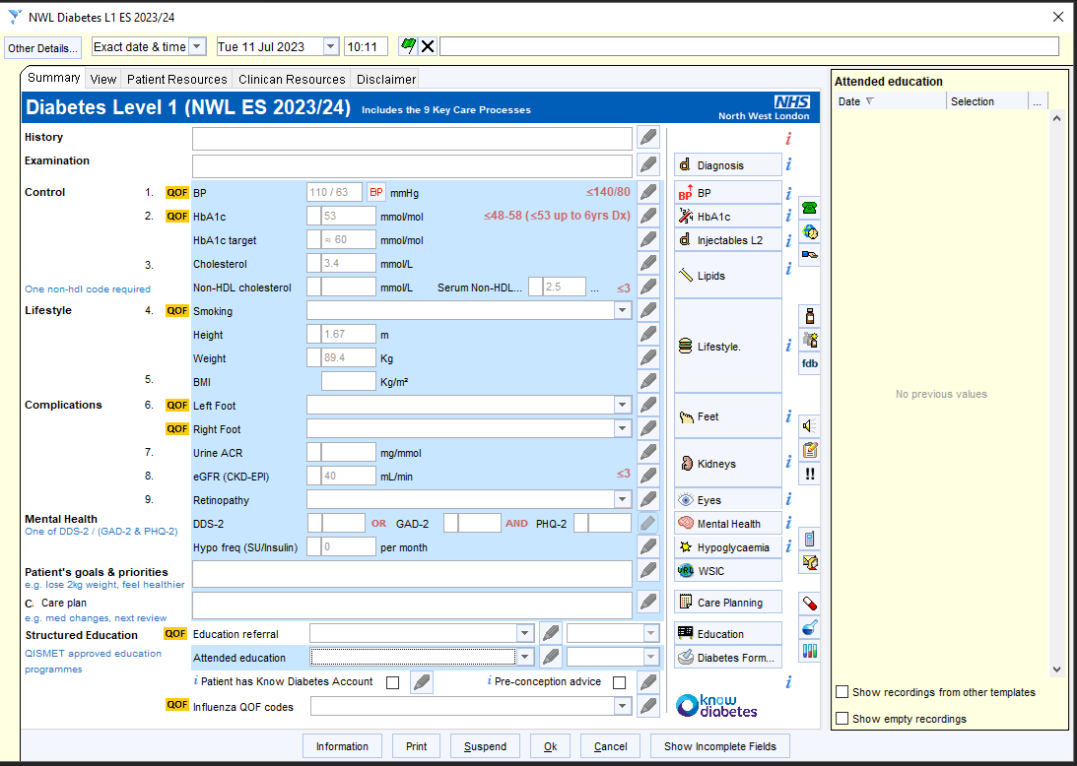
How do I code my patients that have a KDS account?
Practices are now paid £1 for every KDS Account created.
To receive this money:
The Practice will supply an email address via MS teams to receive an email list of patients that have created a KDS account
The KDS provider will then send a list of patients with a KDS account to this email address.
Practices will go into the S1 diabetes template and tick the box that says “Patient has Know Diabetes Account”(image right)

