Slide 1

Newly Immunosuppressed Patients Booking Pathway
February 2024

Slide 2

Newly Immunosuppressed Patients Booking Pathway
Calendar Updated
Office Team updates calendar in ‘Inter-seasonal Campaign’ Folder.
A confirmation email is sent to the patient as a reminder of their booking, location, time etc.
Update GP Practice
Confirm with the GP Practice manager/contact that the patient has been successfully vaccinated (or refused)
GP Email
GP Practice emails Roving Team with referral form
02
Process complete
Patient identified
as newly severely immunosuppressed by treating physician
Patient Contacted
Office Team calls patient to arrange a suitable date for vaccination
Patient attends appointment
A brief clinical assessment carried out • Patient receives vaccination • Details recorded on Pinnacle

Slide 3
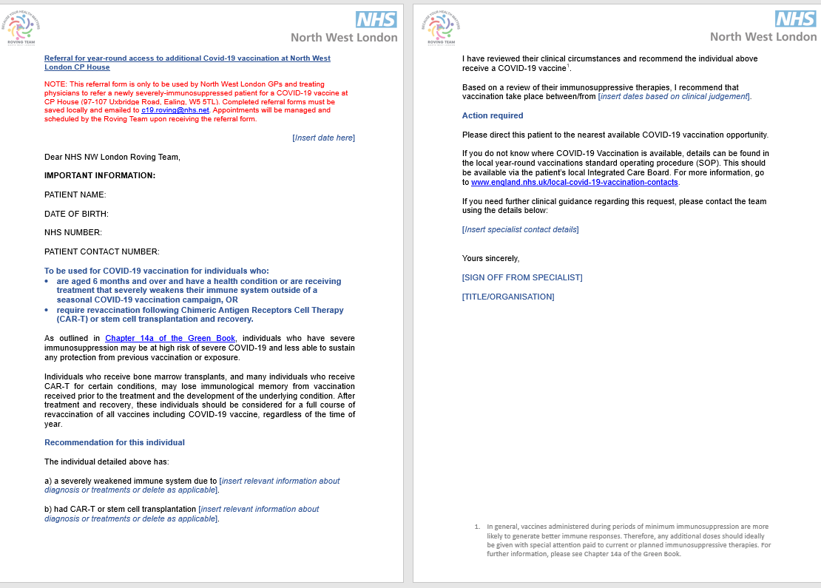
Referral Form

