Slide 1
Primary care Training & Development opportunity for practices and PCNs across North West London
Need more support with triaging and supporting digital access?
Frustrated and angry patients affecting staff morale?
Need some headspace to think through processes that everyone can follow?
Supporting practice reception & administration
Personal resilience and strategies
If this is you or someone you know, please:
Sign up to be part of the next round of our exciting training and development programme aimed at reception and administration team members led by the Digital Transformation and Delivery Team.
Join one of our briefing webinars to find out more and what’s required on
Tuesday 14th January,
Tuesday 21st January 1pm-2pm or
Wednesday 29th January 1pm-2pm
Share this opportunity with colleagues in your practice and PCN who may be interested – we are looking for representation across 2-3 practices in each PCN. Sessions will be mixed with participation from practices across North West London to share learning and experiences
email nhsnwl.digitalfirst@nhs.net to register and receive link or to find out more.
in partnership with

Slide 2
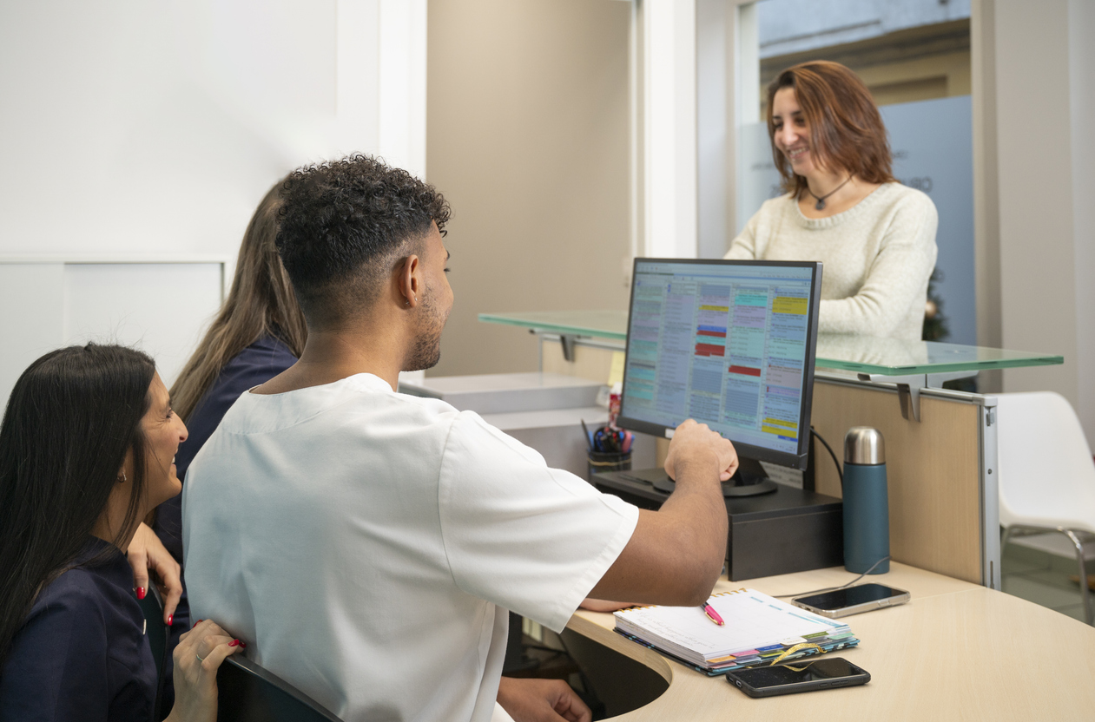
What can I expect to learn?
The programme will help you to:
Establish a consistent approach to triage and request management for the most common requests across practices
Ensure you have the tools, skills and forum to maximise the use of digital tools to help improve access, patient and staff experience
Gain confidence in the use of digital tools to help you do your job more effectively
Feel better supported and empowered to navigate requests effectively, manage complexity and develop stronger personal and team resilience in challenging situations
What is the training and development programme and what will I learn?
What will the format be?
The programme will cover 4 modules:
Dealing with common and frequent (face to face workshop)
Identifying features and inclusions for complexity and how to utilise digital triage when appropriate (face to face workshop)
Improving personal growth and resilience (delivered by Mindfulness UK) (face to face workshop and remote)
Wash up session/reflective practice/community of support (remote)
Who should participate?
We recommend 2-3 people per practice including one person who is a decision maker in the practice and has authority to enact change (practice manager or clinician).

Slide 3
Upcoming dates
Launch workshop/start of cohort | Format | Venue
9th January 2025 | All day face to face workshop (9:30am-4pm) followed by a mix of face to face and remote sessions for the remainder of the programme | TBC depending on attendance
15th January 2025
5th Feb 2025
25th Feb 2025

