Slide 1
Newly Immunosuppressed Patients Booking Pathway
January 2025

Slide 2
Newly Immunosuppressed Patients Booking Pathway
Calendar Updated
Office Team updates calendar in ‘Year Round COVID Vaccinations’ Folder.
A confirmation email is sent to the patient as a reminder of their booking, location, time etc.
Update Referring Clinician
Roving Team confirm with the treating physician/referral lead that the patient has been successfully vaccinated (or refused)
Referral Email
Treating physician emails Roving Team the completed referral form
02
Process complete
Patient identified
as newly severely immunosuppressed by Treating physician
Patient Contacted
Roving Team calls patient to arrange a suitable date for vaccination. This may or may not include a conversation with the Prescribing clinician
Patient attends appointment
A brief clinical assessment carried out • Patient receives vaccination • Details recorded on RAVS (POC)

Slide 3
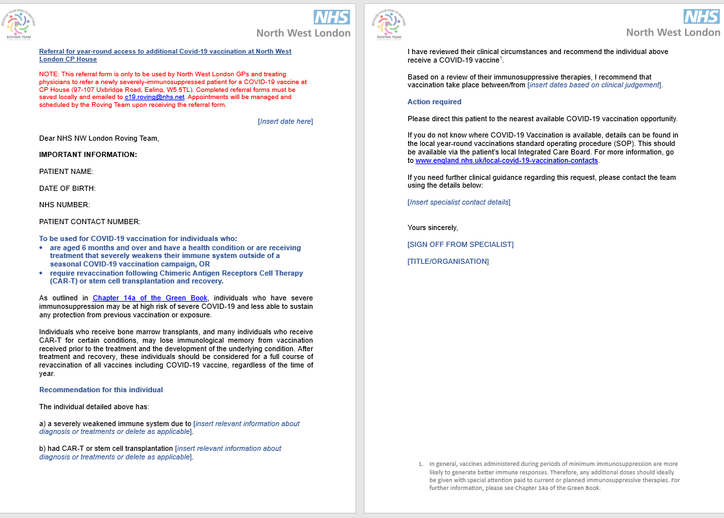
Referral Form

