Slide 1
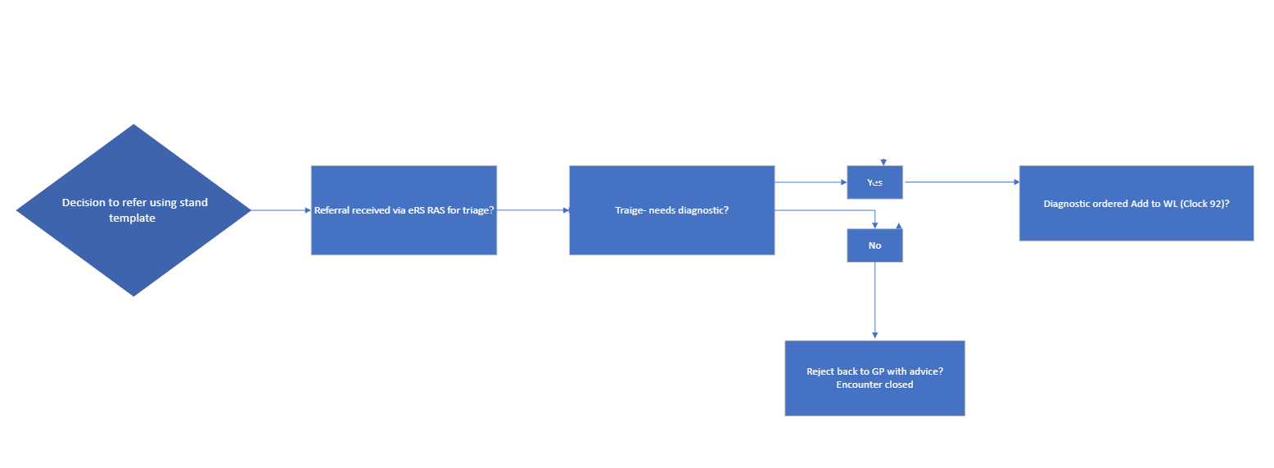
Gastroenterology pathway redesign
Purpose of the pilot
Standardisation of the direct access form for gastroscopies will enhance patient care by ensuring consistent and effective management of the referrals across the APC
Background
Direct access for GPs to refer patients for gastroscopies had not been available at a number of Trusts in NWL. This has been confusing for GPs to manage with the variability across the patch.
Approach
Develop consensus on a new standard referral form to enable all NWL providers to provide direct access endoscopies.
Achievements to date
Gained agreement across NWL on new form and criteria for acceptance.
Implementation of Referral Assessment Service (RAS) on the eRS platform, enabling streamlined and accessible referral pathways for GPs.
Long term benefits
Reduce the percentage of patients receiving a gastroscopy procedure that are agreed between 17-65 years in line with GIRFT recommendation.
Redesigned pathway
The flowchart below demonstrates the new best practice pathway:
For more information
Please contact: Simone Brown/Anet Soubieres, project leads, simone.brown7@nhs.net
a.soubieres@nhs.net

