Slide 1
NWL Respiratory Champions
Role description & support offer

Slide 2
PCN Respiratory Champion Role
Are you passionate about improving respiratory care?
Join us as a Respiratory Champion as part of the Respiratory Enhanced Service.
In this exciting role, you'll play a key part in enhancing respiratory care, supporting your PCN in meeting targets, and making a real impact on patient outcomes.
Your experience, enthusiasm and collaboration can drive meaningful change, benefiting both your colleagues and the communities you serve.
We encourage all allied health professionals to consider taking on this role. Although there is only a need to have 1 official champion per PCN, we encourage all interested clinicians to consider becoming part of the Community of Practice.

Slide 3
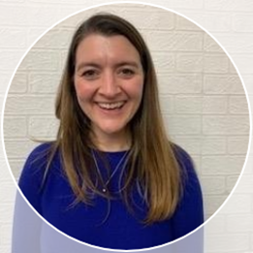
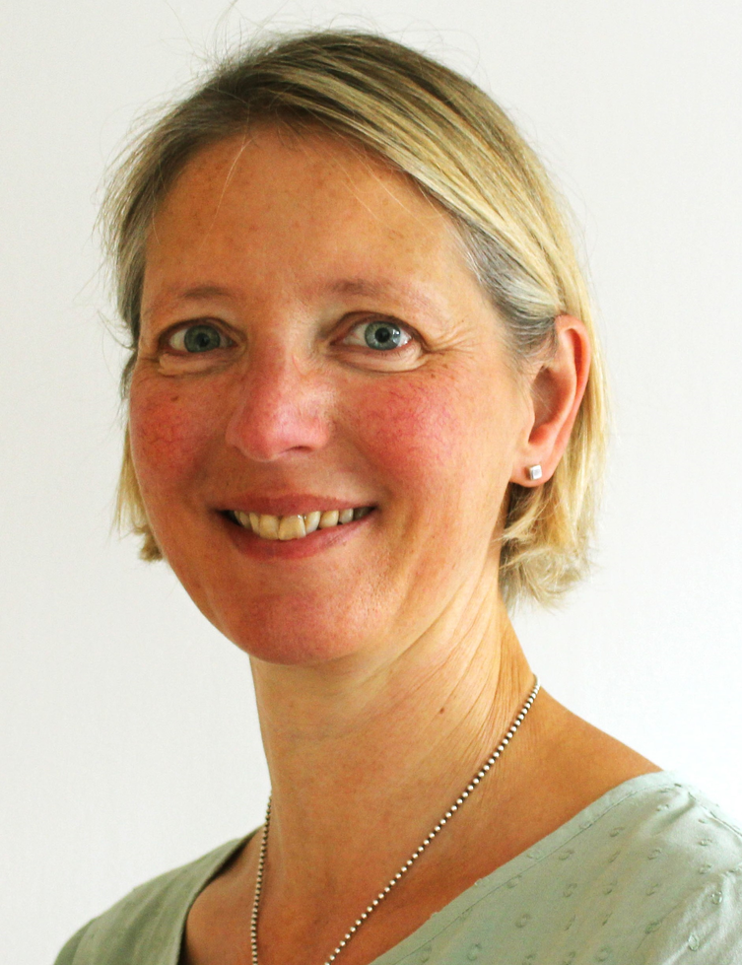
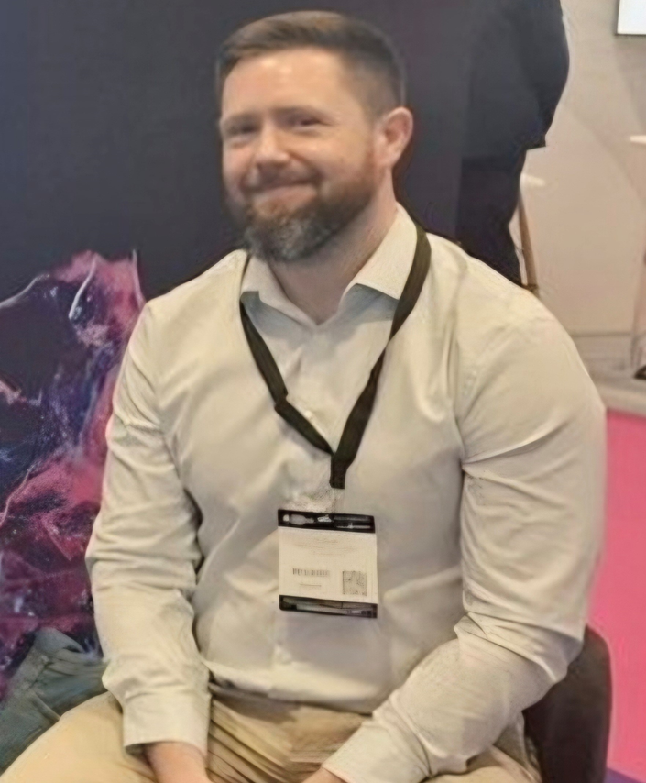
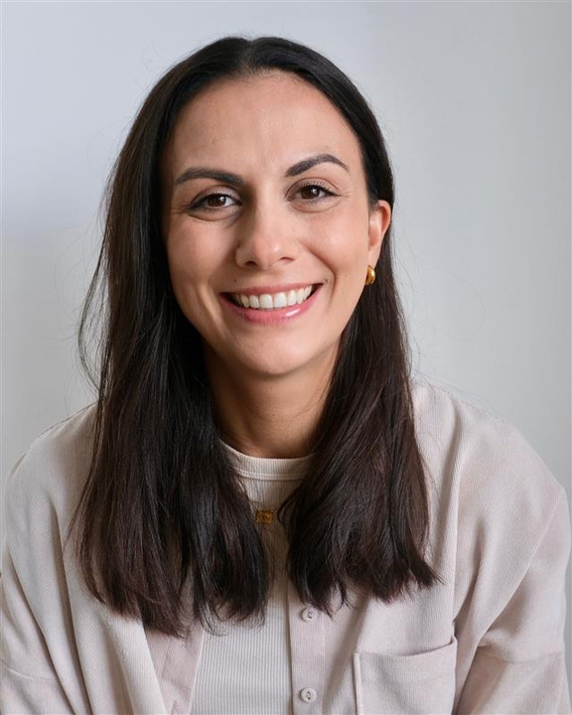
Meet the Team - We’re here to help
We really want to make sure that you feel supported in this role and we are here to help where we can.
Dr. Ellie Worthington
NWL Respiratory and Post Covid Syndrome GP Clinical Lead
Sally Armstrong
Nurse Director - NWL
Training Hub
Phil Brough
Head of Planned Care
– NWL ICB
Sarah Mumeni
Project Delivery Manager – NWL ICB Long Term Conditions

Slide 4




Respiratory Champion role aims
Expertise Development and Staff Training
Building up expertise and encouraging wider staff training and the promotion of best practice.
Enhanced Service Specification Targets
Helping PCN and practices to meet the specification of the Respiratory Enhanced Service and targets to ensure payment.
Population Health Insights through WSIC Dashboard
Interacting with WSIC Dashboard (COPD and LADS) to understand local population trends and health inequalities.
Integration with Local Services and Community Networks
Connecting with local services and participating in evolving multidisciplinary teams and communities of practice.

Slide 5

Training offer to support you in your roles
We’re keen to ensure you have the right training and support for your role, and so are pleased to offer the following opportunities:
Paid membership to the Primary Care Respiratory Society (PCRS) for two staff members per PCN, with applications submitted via the NWL Training Hub. It is recommended that the PCN champion be one of the members.
Access to CPD funding for Foundation Modules in Asthma, as well as professional development opportunities for nurses and AHPs.
Foundation Modules for Pharmacists, limited to one pharmacist per PCN.
Advanced training modules for PCN Respiratory Champions, available to one champion per PCN.

Slide 6

Respiratory Community of Practice
One of the things we are most excited about is the Community of Practice we are building:
To enable you to collaborate, share learning and promote best practice.
A dedicated MS Teams channel has been created to facilitate ongoing discussions, resource sharing, and collaborative problem-solving.
Monthly touch point meetings facilitated by local respiratory experts have been set up for further support.

Slide 7
Questions
Please ask us any questions about the role!
If you have any questions, please contact s.mumeni1@nhs.net

